Slide 1
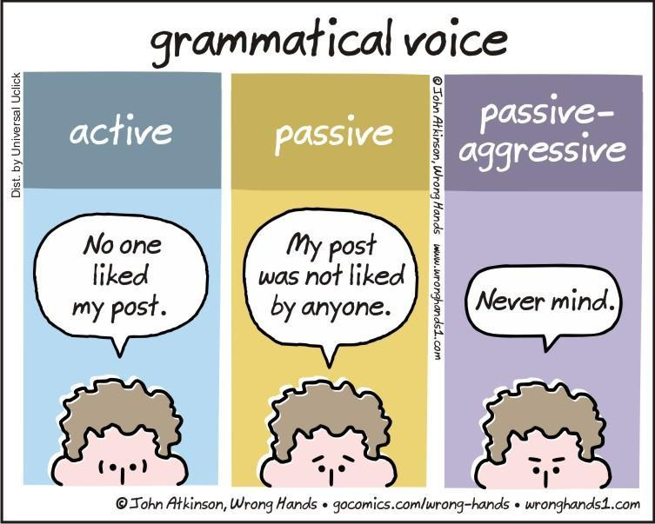
Grammar & Basica
The Passive

Slide 2
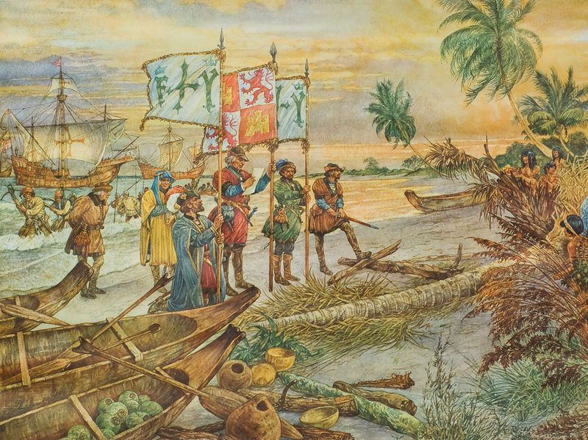
Consider this text:
Christopher Columbus was a navigator and a colonizer. He was born in Italy in 1451. In 1492 Columbus discovered America. He thought he had discovered Asia!

Slide 3
What is the text about?
This text is about Columbus.
The focus is on what he did.
Columbus is the subject and the agent.
“Columbus discovered America” is an active sentence.

Slide 4

Now consider this text
The United States of America is a republic, which consists of 50 states.
The capital is Washington. In 1492 America was discovered by Christopher Columbus.

Slide 5
What is this text about?
This text is about the USA. The focus is on what happened to it.
America is the subject, but Columbus is still the agent
“America was discovered by Columbus” is a passive sentence.

Slide 6
The passive
Columbus discovered America.
America was discovered by Columbus.
What has changed?

Slide 7
Active
Columbus | discovered | America
subject | verb | object

Slide 8
Passive
America | was discovered | by Columbus
subject | verb | adverbial (agent)

Slide 9
What has changed?
The object of sentence one (America) has become the subject.
Columbus discovered America.
America was discovered by Columbus.

Slide 10
What else has changed?
Columbus discovered America.
America was discovered by Columbus.

Slide 11
What else has changed?
Columbus discovered America
Past simple
America was discovered by Columbus
form of ‘to be’ (in the same tense) + past participle

Slide 12
How to make an active sentence passive
Make the object of the active sentence the subject of the passive sentence
Use a form of (to) be in the same tense and use the past participle (of the verb in the active sentence)
If relevant, the subject of the active sentence can be put at the end in an adverbial (by-phrase)

Slide 13
How to make an active sentence passive
John | opens | the door
subject | verb | object
The door | is opened | (by John)
subject | verb | object

Slide 14
The Passive
We saw an example of the past simple tense
(America was discovered by Columbus)
and
of the present simple tense
(the door is opened)
The passive can be used in nearly all of the tenses

Slide 15
Tenses and the passive
Form | Active | Passive
Present simple | They clean the house | The house is cleaned (by them)
Present continuous | They are cleaning the house | The is being cleaned (by them)
Present perfect | They have cleaned the house | The house has been cleaned (by them)
Past simple | They cleaned the house | The house was cleaned (by them)
Past continuous | They were cleaning the house | The house was being cleaned (by them)
Past perfect | They had cleaned the house | The house had been cleaned (by them)
Future | They will* clean the house | The house will be cleaned
* Same for all modal verbs

Slide 16
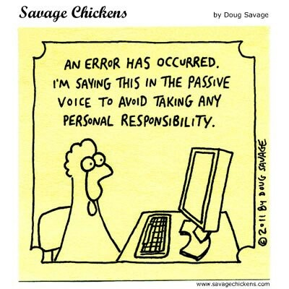
Passive
Special cases

Slide 17
Verbs that take two objects
Verb | Active | Passive
give | The nurse gives the patient a sleeping pill. | A sleeping pill is given to the patient.
 |  | The patient is given a sleeping pill.
allow, ask, feed, send
 | The man fed the horse a bale of hay. | A bale of hay was fed to the horse.
 |  | The horse was fed a bale of hay.

Slide 18
Exceptions (I)
Verb | Active | Passive
Verbs without object
happen | Something happened | x
stay | We stayed at home
Some state verbs
lack | The player lacks talent | x
have | We have three dogs | x

Slide 19
Exceptions (II)
Verb | Active | Passive
Verbs that are action and state verbs. Only passive when they are action verbs (cost, fit, measure, weigh)
As a state verb
weigh | The person weighed 80 kilos | -
As an action verb
weigh | The woman weighed the apples on the scale | The apples were weighed on the scale (by the woman)

Slide 20
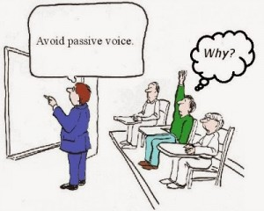
Passive
usage

Slide 21
When to use? - I
When we focus on the person/thing undergoing the action (even though the agent is mentioned)
America was dicovered by Columbus.
You find this in formal, academic writing, textbooks, news reports.

Slide 22
When to use? - II
3. When we don’t know who the agent is (and cannot possibly know).
My bike has been stolen.
The house was broken into.

Slide 23
When to use? - III
4. It’s irrelevant to mention the agent.
4a. Because it’s obvious:
Yesterday the thief was arrested.
This is the hospital where she was treated.
4b. Because the emphasis is on the process, not the ones doing it:
The water is heated in a test tube.

Slide 24
When to use? - IV
5. When the agent is everyone/ (a group of) people in general.
Books can be borrowed at a library.
English and French are spoken in Canada.

Slide 25
When to use? - V
6. When you choose not to mention the agent to avoid blaming anyone.
Mistakes were made.
I’m afraid the wrong products were sent to us.

Slide 26
Translating
Watch out when translating Dutch “er”:
Er zijn veel mensen ontslagen.
*There have been many people fired.
Many people have been fired.

Slide 27
